Slide 1
Workshop for Problem Understanding
Chapter 14

Slide 2
READ ME!
This is an example slide deck for running the ‘Workshop for Problem Understanding’, described in Chapter 14.
This slide deck is bland. This is intentional. In this way, you can see the message that you need to get across in each slide, without distracting animations, colours, or images.
It is up to you to modify this slide deck to your own needs and preferences.
My own preferred style is to have few words, concepts, and images on a slide. This allows the users to focus upon what you are saying in the room.
To understand what you should be saying at that point in the slide presentation READ THE NOTES FOR THAT SLIDE. Notes typically are displayed underneath the main window.
Also, I tend to animate my slide text, so that if I have five bullet points then I will put each bullet point on the slide deck one at a time. This avoids putting a whole slide full of text in front of your viewers, who then promptly read through the entire slide deck and miss what you’re saying.
This approach means that you end up with a larger number of slides, but that doesn't matter.
You may find it helpful to watch a Ted Talk YouTube presentation "death by PowerPoint", which explains this approach.
https://www.youtube.com/watch?v=Iwpi1Lm6dFo

Slide 3
Agenda
Notes:
Provide a suitable agenda.
The following 2 slides give a suggested agenda for 2-days and 1-day respectively.
Delete the one that is not appropriate to you and then modify the remaining one, so that it matches your final agenda and slide deck.

Slide 4
Agenda
Day 1
Introduction (30 minutes)
Understanding trade-offs (90 m)
BREAK (15 m)
Understanding trade-offs (90 m)
LUNCH (60 minutes)
Understanding systems effects (90 m)
BREAK (15 m)
Anti-patterns (90 m)
Summary of day 1 (15 m)
Day 2
Recap of day 1 (15 m)
Debt from an economics PoV (90 m)
BREAK (15 m)
Wicked problems, social complexity, and fragmentation (90 m)
LUNCH (60 minutes)
Putting it all together (180 m)
Summary of day 1 and 2 (30 m)
Notes:
This is an example agenda for a 2-day workshop for Problem Understanding of Technical Debt.
Day 1 – If you start at 9:00, you will be finished at 17:15.

Slide 5
Introduction
Notes:
You should aim to run through this introduction section in 30 minutes.
The thing is to watch out for are spending too much time on the introductions.
The introductions serve the purpose of being an icebreaker, so that people relax, plus to get people to know each other a bit better.
For these reasons, you want to start small. Have people talk to each other one on one. Next, get each pair to talk with another pair.
Stop at this point.
Avoid a big "roundtable" introduction, where everybody speaks for a minute or two. This approach can easily suck 30 minutes out of your schedule before you even notice it.

Slide 6
Introduction
Agenda Items
Introduce to each other
What is technical debt?
Technical debt onion
Notes:
Note: you should already have covered the agenda items. This item is a reminder, in case you have not done that yet

Slide 7
Introduce to each other
Introduce yourself
Turn to your neighbour
Each spend 1 minute introducing yourself to each other
Turn to group beside you
Each spend 1 minute introducing your neighbour to the group
Notes:
Start by giving a BRIEF introduction of yourself that is relevant to the group and the workshop. Spend no more than three minutes on this.
Next, as an icebreaker, get each person in the workshop to turn to their neighbour and introduce themselves to each other.
Next, get each pair to turn to the pair beside them and introduce their new friend.
All this should take no more than 10 to 15 minutes

Slide 8
What is technical debt?
The implied cost of future reworking
required when choosing an easy but limited solution
instead of a better approach that could take more time. - Technopedia
Technical debt is not primarily a technical problem
Technical debt is a trade-off problem
Additional complexities
Notes:
Start by asking what is technical debt.
After a brief discussion, put up the definition of technical debt.
Next, ask workshop members for what this definition implies about technical debt.
Now, introduce the point that technical debt is not primarily a technical problem.
Instead it is the consequence of making a trade-off decision, where we trade-off technical debt in order to receive a benefit, such as additional features or early delivery.
Finish by pointing out there are some additional complexities, which will lead you into the technical debt onion on the next slide.
Aim for a maximum of about 5 minutes on this slide.

Slide 9
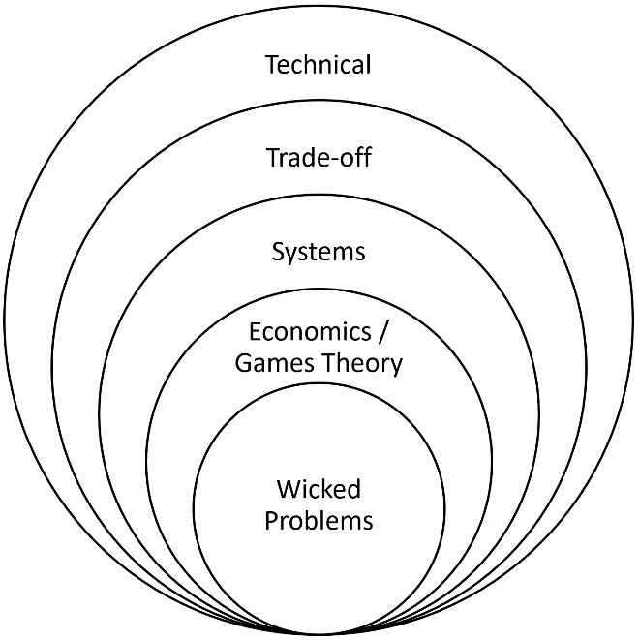
The technical debt onion
Notes:
Talk the workshop members through the technical debt onion, beginning with the technical layer and finishing with the wicked problems layer.
Briefly explain what each layer is, plus how each layer relates back to the workshop agenda.
Also, explain that you must address each of the layers in order to solve the technical debt problem.
For example, if you are dressed trade-offs, but ignore systems effects, those systems effects will render your solution, based upon addressing trade-offs, ineffective.
Aim for a maximum of about 10 minutes on this slide.

Slide 10
Understanding trade-off decisions
How we make decisions
Notes:
You should aim to spend around 90 minutes in this section.

Slide 11
Understanding trade-off decisions
Technical
Trade-off
Wicked Problems
Economics/Game Theory
Systems
Notes:
BRIEFLY identify that this section will be covering the trade-off layer of the technical debt onion.

Slide 12

Which dictionary is more valuable?
You previously valued one of these two music dictionaries
Which would you pay more money for?
We actually valued dictionary A more highly
Why?
Explained later
Notes:
Begin the workshop by getting people hands-on in an exercise.
As people walk into the workshop, direct attendees to one of two tables, separated by enough distance that when standing by one table you cannot see in detail the items on the other table.
Each table should be manned by yourself or a helper who understands the experiments of Christopher Hsee.
Get people to put a value on the music dictionary, plus any other items you have displayed (ice cream, cookery).
In addition, if funds permit, get people to make a choice as to whether to take a gamble or accept a risk-free choice of a small sum of money (another experiment of Christopher Hsee).
NOW, use the results of workshop attendee choices to demonstrate that we make decisions not based upon rational choice but upon emotions, or the affect heuristic.
Hold the music dictionaries before the audience and ask them which dictionary they would pay more for?
Repeat this for you other demos
Now reveal that we valued the dictionaries (and other items) differently from what they expected.
Explain that this will be explained later, then go to the next slide.
(Recreate the experiments of Christopher Hsee for music dictionary/ice cream/crockery.
The music dictionary experiment was described in the trade-off chapter, whilst the other experiments are described in his papers listed in the references.)

Slide 13
How do we make decisions?
Decision-making evolved to help us survive & prosper
Good at some decisions, poor at others
Requirements for an effective decision-making system
Notes:
Ask attendees how they believe they make decisions.
Explain here that decision-making evolved to help our ancestors survive and prosper within the environment that they lived in.
This means that we will be very good at certain types of decisions – those that are similar to the ones that our ancestors faced – and we will be very poor at other types of decisions – ones that our ancestors did not face.
In addition, explain that we can also work out some requirements for what would have been an effective decision-making system for our ancestors, and what those requirements imply for our own decision-making.

Slide 14
Requirements for effective decision-making
Fast.
Function well, even with poor quality information.
Impose a low cognitive load.
Decision-making must occur in our subconscious.
Conscious reasoning is too slow.
Conscious, logical reasoning works badly with poor quality information.
Reasoning imposes a high cognitive load on us.
Notes:
Get attendees to identify what conditions were like for our ancestors (refer to the relevant part of chapter 5, if you are unsure. Write up on whiteboard.
Next, get attendees to identify what would be the requirements for a suitable decision-making system to perform well in that environment.
Fast. It must be fast enough to respond effectively to the threats it faced, which could materialise extremely rapidly.
Function well, even with poor-quality information. Information was limited to what our ancestors could observe or, after language developed, what they were told by people whom they already knew. Much of this information would have been incomplete, ambiguous, conflicting, or even part of a deception attempt by a predator, prey, or rival. Nevertheless, their lives depended upon making good decisions based on this information.
Impose a low cognitive load. When facing a threat, you want all your cognitive facilities available for monitoring and responding to that threat, rather than engaged in deep analysis.
Next, get the attendees to try and identify the implications for that decision-making system (as above)

Slide 15
The affect heuristic
Uses your current feeling/emotion to guide your decision
Benefits:
Fast.
Function well, even with poor quality information.
Impose a low cognitive load.
Disadvantages
Poor decisions if does not map to decision types from our past
Notes:
Explain what the affect heuristic is.
Your GUT FEEL
Explain the advantages of the affect heuristic.
Then, explain the potential disadvantages. Highlight that we made a poor decision about the music dictionary.
Also, highlight that the affect heuristic contributes to us making decisions that result in us taking on too much technical debt.

Slide 16
When the affect heuristic fails
Uses your current emotion
Characteristics that touch emotions affect decisions.
Characteristics that do not touch emotions do not affect decisions.
Notes:
Explain to attendees that characteristics that influence your emotions will play an important part in decision-making.
In contrast, characteristics that do not touch your emotions will play little or no part in a decision.

Slide 17
The technical debt trade-off decision
New Feature
Immediate
Certain
Concrete
Experienced by us
Emotional
Technical Debt
Future
Uncertain
Intangible
Experienced by others
Rational
Notes:
Remind attendees that technical debt is the consequence of a trade-off decision, where decision-makers choose a trade-off, typically between new features/early delivery and technical debt.
You can have a new feature, provided you pay for it, either with real resources or technical debt.
You can have earlier delivery provided you pay for it…
Next, ask the attendees what are the characteristics of choosing a new feature.
Get the attendees to list out the characteristics, then reveal the characteristics on the left-hand side of the above slide.
Next, repeat by asking the attendees what are the characteristics of technical debt.
Immediate. You get to enjoy the feature just as soon as the code is delivered.
Certain. You know what you are getting, or believe you know, as you have a specification, screenshot, or mock-up of it.
Concrete. Or rather, as concrete as anything ever gets in software.
Experienced by us. You get to enjoy the feature or enjoy the credit for delivering that feature to end-users.
Emotional. You want the feature, as it will do good things for you and your end-users.
Future. Any debt repayment will affect you in the future.
Uncertain*. As we discussed in the chapter on broken analogies, you don’t know when you’ll have to repay this debt, how much you’ll have to repay, or indeed if you ever do need to repay it. This is a key difference between ordinary debt and technical debt.
Intangible*. At this point you’re not entirely sure what the future repayment would consist of. It might be a major rework, or it may be a few minor changes.
Experienced by others. This future work is likely to be picked up by another person. If you count your future self as a different person, and many psychologists believe we do, then this debt will definitely be experienced by others.
Rational. Avoiding this technical debt is a bit like saving for your pension. You know it’s a good idea, but it appeals to your rational sense, not your emotions.

Slide 18
Affect heuristic and smoking prevention programmes
Benefits of smoking
Perceived as ‘Cool’
Immediate
Certain
Concrete
Experienced by us
Emotional
Disadvantages of smoking
Risks to future health
Future
Uncertain
Intangible
Experienced by others
Rational
Notes:
Ask attendees – what are the characteristics of smoking, as perceived by teenagers. Then reveal how those characteristics map to the affect heuristic.
Next, go through the history of smoking prevention campaigns, beginning with the health message added on to cigarette packets.
Ask, what with the characteristics of that message.
Ask, would that message appeal to the affect heuristic of teenagers.
Get attendees to recognise why the smoking awareness campaigns based upon this health message had limited impact on smoking prevention.
Before you go to the next slide, ask what has changed?

Slide 19
Affect heuristic and smoking prevention programmes
Notes:
Display a cigarette packet from a period when tobacco companies were allowed to put their own images onto the packet.
Beside it, display a modern cigarette packet, with its generic packaging and graphic, visceral image of damage to human body parts caused by smoking.
Ask attendees how this change in approach may have influenced teenagers' decisions regarding beginning smoking.

Slide 20
Implications for addressing technical debt
If you want to shift decisions towards avoiding technical debt, then you must shift those technical debt arguments away from logic and towards emotion.
Notes:
Discuss with attendees what the imprecations of this are for technical debt.
You may wish to use the 1-2-4-All technique to get greater engagement.

Slide 21
Why do second hand car dealers valet their cars?
Notes:
If time permits, facilitate a discussion on why a second-hand car dealer always ensures his vehicles are valeted to a high standard. Ask the group for other examples. (The answer is that the dimensions the customer is interested in – condition of the engine, transmission, running gear, and so on – are not easily evaluable. However, the cleanliness of the car is, so potential customers use this as a proxy.) Use 1-2-4-All.

Slide 22
Appeal to emotions through a story
You need a good story. You want a story that fits the following criteria:
The issue could not be addressed at the time (typically due to project pressures)
The business stakeholders assured everyone the issue would be fixed in the future
Repeated opportunities to fix it were passed over
Not fixing the issue became painful
<Example story here>
Notes:
Point out to attendees that will mean you can influence the affect heuristic is through telling a story.
Show attendees how you can use a story of a specific item of technical debt to appeal to people's emotions.
You can use the example of the HMV multiple genres story in chapter 5, or you can use your own story.

Slide 23
Exercise - Appeal to emotions through a story
Develop a story about a specific technical debt at your organisation.
Think how it could be used to appeal to the affect heuristic of decision-makers considering a technical debt trade-off.
Notes:
Get people to break into groups and develop a story based around an item of technical debt. We should have the characteristics outlined on the previous slide.
You can use the 1-2-4-All technique, spending 3 to 5 minutes at each stage. Start by getting people to spend three minutes thinking alone about a technical debt problem story, then join in pairs for 3 to 5 minutes to discuss each story, then joining two pairs into fours to discuss the two best stories, then discussing the best story from each group.
Alternatively, if you have less time available, you could start with groups of four.

Slide 24
BREAK

Slide 25
Understanding trade-off decisions
Mitigation approaches

Slide 26
Precision and Valence
Notes:
Now is the time to explain why we made the decisions we did for the music dictionaries and other items.
EXPLAIN TO ATTENDEES NOT TO REVEAL THESE EXERCISES TO COLLEAGUES WHO WILL BE ATTENDING LATER SESSIONS

Slide 27
Remember this? Which dictionary is more valuable?
You previously valued one of these two music dictionaries
Which would you pay more money for?
We actually valued dictionary A more highly
Why?
Explained later
Notes:
It is now time for you to return to the experiments of Christopher Hsee.
Ask attendees – given what they now know about how they make decisions using the affect heuristic, why is it that they valued dictionary A more highly than dictionary B when viewed separately but reversed their valuation when viewed together?
Now go into precision and valence, as discussed in chapter 5.
Do this for each of the demos that you provided (for example, music dictionary, crockery, ice cream, gambling option).
Next, discuss those characteristics of new features/early delivery and the characteristics of technical debt.
(Typically, the characteristics of new features and early delivery a very precise, whereas the characteristics of technical debt lack any precision).
Next, discuss how this will influence how we make our trade-off decision around technical debt.
Next, ask what we can do about it. This leads into the next exercise.
Spend no more than 15 minutes explaining this concept.

Slide 28
Exercise - Precision and Valence
Break into groups.
Discuss and explore how you can increase the precision of any characteristics of technical debt.
Notes:
Get your workshop attendees to break into small groups (or use the 1-2-4-All technique).
Get them to discuss ways of how they can increase the precision of the characteristics of any specific technical debt.
As individuals create ideas, you may wish to get them to write them onto post-it notes and put them into a common area.
Depending on the time available, you may wish to spend 15 to 30 minutes on this activity.

Slide 29
Ulysses contracts
Notes:
Explain the story of Ulysses.
Explain how this translates into Ulysses contracts.
Lead into the next slide, where attendees will think up ways that they could apply Ulysses contracts to address the technical debt problem.
It should take 5 – 10 minutes to explain this idea.

Slide 30
Exercise - Ulysses contracts
Notes:
Get your workshop attendees to break into small groups (or use the 1-2-4-All technique).
Get them to discuss ways of how they can use a Ulysses contract to address their technical debt problem.
Once again, aim to get the ideas onto post-it notes and a common area where people can view each other's ideas.
Aim to spend 5 – 15 minutes in this exercise.

Slide 31
Simultaneous versus sequential decisions
Notes:
Use the company canteen example to explain the concept of simultaneous verses sequential decisions.
People can usually easily relate to the concept of making a series of unhealthy choices when faced with appetising dishes in a canteen whilst they are feeling hungry.
People can also usually accept that they would make better choices if they made several choices at the same time, at the point when they were not feeling hungry.
Next, explain how this relates to a series of sequential decisions on projects, each one resulting in additional technical debt being created.
Next, leading to the exercise on the next slide.

Slide 32
Exercise - Simultaneous vs sequential decisions
Notes:
Get your workshop attendees to break into small groups (or use the 1-2-4-All technique).
Get them to discuss ways of how they can use the concept of simultaneous verses sequential decisions to improve decision-making around technical debt.
Once again, get the ideas onto post-it notes and into a common area.

Slide 33
Pre-mortem technique
Notes:
If time permits, explain the pre-mortem technique. In this technique, we try to spot unanticipated risks through imagining ourselves in a future scenario where the problem has materialised.

Slide 34
Exercise - Pre-mortem technique
Notes:
Get your workshop attendees to break into small groups (or use the 1-2-4-All technique).
Get them to discuss ways of how they can use the pre-mortem technique to improve decision-making around technical debt.
Once again, get the ideas onto post-it notes and into a common area.

Slide 35
Other factors that influence decisions
Overdue projects and crazy risk taking
Effect of time constraints
Hyperbolic discounting
Notes:
Point out to attendees that technical debt is a trade-off decision, one that is driven primarily by the affect heuristic. However, other factors also influence your decision.
One important factor is that technical debt decisions are normally made within a project. Whether that project is on track or, more commonly, behind schedule, has a profound effect upon those technical debt decisions.
Next point out that you will be talking about three things that influence decisions:
How overdue projects change our risk appetite.
How we make different decisions when we are under time constraints.
And how bias known as "hyperbolic discounting" causes us to undervalue future costs.

Slide 36
Overdue projects and crazy risk taking
Notes:
Use examples from prospect theory to show how we will make risk adverse decisions under conditions of gains, but risk seeking decisions under conditions of losses.
Discuss how under conditions of losses we also tend to make decisions that economists would deem irrational. For example, we fail to maximise utility. The most obvious example of this is that we will abandon partly built code and functionality in order to try and get the project back on schedule.
Get the attendees to break into small groups, or use 1-2-4-All, to explore examples of how conditions on an overdue project may encourage poor decision-making.
Next, get attendees to think up possible mitigation approaches (for example, avoid project underestimation).
Once again, get those ideas onto post-it notes and onto a board in the commentariat.

Slide 37
Effect of time constraints
Notes:
Get attendees to recall the characteristics of making decisions using the affect heuristic. Principally they are:
Fast.
Works well even in the absence of complete information.
Does not impose a large cognitive load on you.
Now get attendees to consider what will happen if you are under severe time constraints. The answer is, of course, that when under severe time constraints we relied more on the affect heuristic for decision-making and less upon rational logical judgement.
Get the attendees to consider what this means for decisions made on projects where all project personnel are under severe time constraints.
You can get the attendees to break into groups or use the 1-2-4-All technique.

Slide 38
Hyperbolic discounting
Notes:
Begin by asking attendees – what we really mean when we say we have too much technical debt?
Next, define what hyperbolic discounting is (a tendency to have a stronger preference for more immediate payoffs, relative to later payoffs).
Next, get attendees to break into groups and discuss the implications of hyperbolic discounting on projects, plus possible ways of mitigating its effects.

Slide 39
Exercise - how to change decision-makers perception of technical debt
Notes:
Close this session with a brainstorming session or discussion around how to change decision-makers perception of technical debt, so that they can make decisions that are more closely aligned to the long-term interests of the organisation.

Slide 40
Summary – trade-off decisions
Notes:
Give a summary of the major points of this section – understanding trade-off decisions.
Begin with the affect heuristic, its relevance to our decision-making, why it is useful, and why it causes us problems when we try to make decisions about technical debt.
Next, talk about potential mitigation approaches:
Attach greater emotion to characteristics through use of stories.
Attach greater precision to technical debt characteristics.
Ulysses contracts.
Simultaneous versus sequential decision-making.
Next, remind attendees that we make different decisions, particularly around risk, when projects become overdue. Talk about the implications of this, plus how you may mitigate it.
Next, talk about the effect of time constraints on decisions.
Next, talk about hyperbolic discounting.

Slide 41
LUNCH

Slide 42
Understanding systems effects
Notes:
Refer to chapter 6 when you want to create material for slides in this section.

Slide 43
Understanding systems effects
Technical
Trade-off
Wicked Problems
Economics / Game Theory
Systems
Notes:
Identify to workshop attendees that we have now finished looking at technical debt as a trade-off problem and are now beginning to look at technical debt as a systems problem.

Slide 44
What is a system?
A system is a set of elements or parts
that is coherently organised and interconnected
in a pattern or structure
that produces a characteristic set of behaviours,
often classified as its ‘function’ or ‘purpose’.
Notes:
Begin by asking the workshop what is meant by a system.
Next, show Donella Meadows' definition of a system, as shown on the slide.
Next, identify the three crucial characteristics of a system.
Parts. Something that has only one part, such as a ball, is not a system.
Interconnected parts. A lead weight and a piece of string are not a system. But if you connect the lead weight to the string and suspend it from the ceiling, then you have a pendulum system.
The structure of the interconnections produces a characteristic set of behaviours or patterns. For example, the pendulum produces a regular, periodic motion, where the length of the string determines the period of the motion.
Identify to the attendees that the third point is particularly important for technical debt.
It is the structure of the organisation that determines the patterns it produces, including the patterns of technical debt generation and removal.

Slide 45
Slinky Demo
Notes:
Get your slinky out and demonstrate Donella Meadows' definition, as shown in her YouTube video.
If funds permit, have a slinky available for each attendee to play around with. Getting attendees and hands-on is one of the best ways to get them to learn about systems effects.

Slide 46
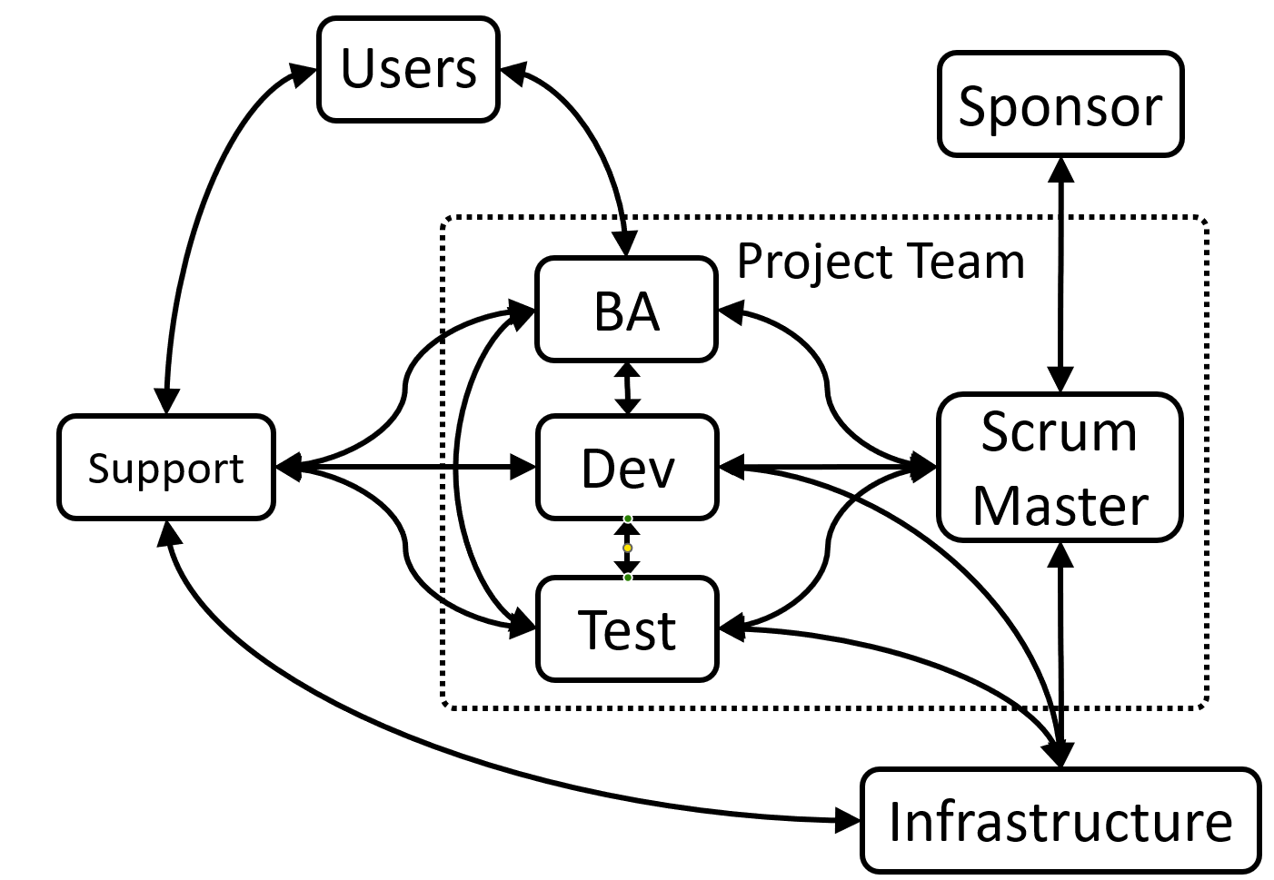
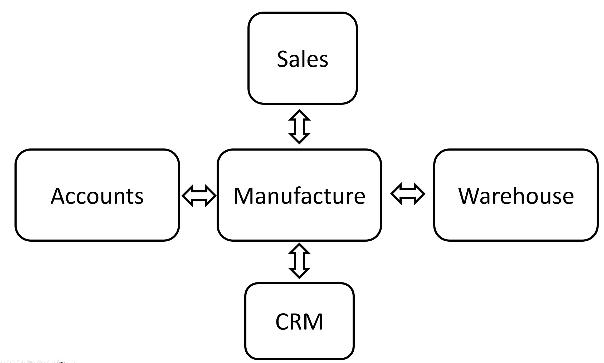
The organisation as a system
Notes:
Begin with an analogy to an ERP or other IT system.
Most attendees will be familiar with thinking of an IT system in terms of systems thinking.
Next, use the analogy to help attendees think of their software development organisation as a system.
Use diagrams, as above, if you find this helpful.

Slide 47
Crucial difference between IT systems and social systems
Notes:
Identify that there are crucial differences between IT systems and social or biological systems.
Most importantly, these components or subsystems within an IT system lack the ability to determine and pursue their own goals.
Discuss how this ability in social biological systems leads to conflict.
Try using the example of conflict between the Y chromosome and placenta in the different strains of mice, discussed in chapter 6.
If time permits, get the attendees to do an exercise to try and predict the outcome of crossing mice from the monogamous and promiscuous strains.
(You will find this useful later, as you can demonstrate the difficulty in predicting how systems behave without considering their dynamic behaviour).

Slide 48
Introducing change – the Prohibition problem
Notes:
Discuss out introducing change into a social or biological system can lead to unexpected results, as the subsystems or actors within it are just their response to pursue their own personal goals.
Use the example of prohibition in the USA to demonstrate unexpected results.

Slide 49
Common dynamic system behaviours
Notes:
Identify to attendees that you will now be taking them through some common dynamic system behaviours.
For further details of these, referred to in chapter 6.

Slide 50
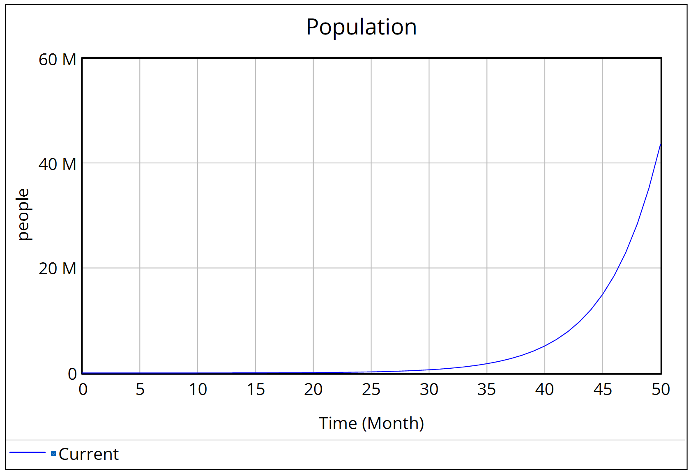
Exponential growth
Notes:
Explain that this behaviour occurs when there is a reinforcing or positive feedback loop present in the system, plus conditions are such that the reinforcing loop dominates system behaviour.
One example is the unpleasant acoustic feedback you get by holding a microphone too close to a loudspeaker.

Slide 51
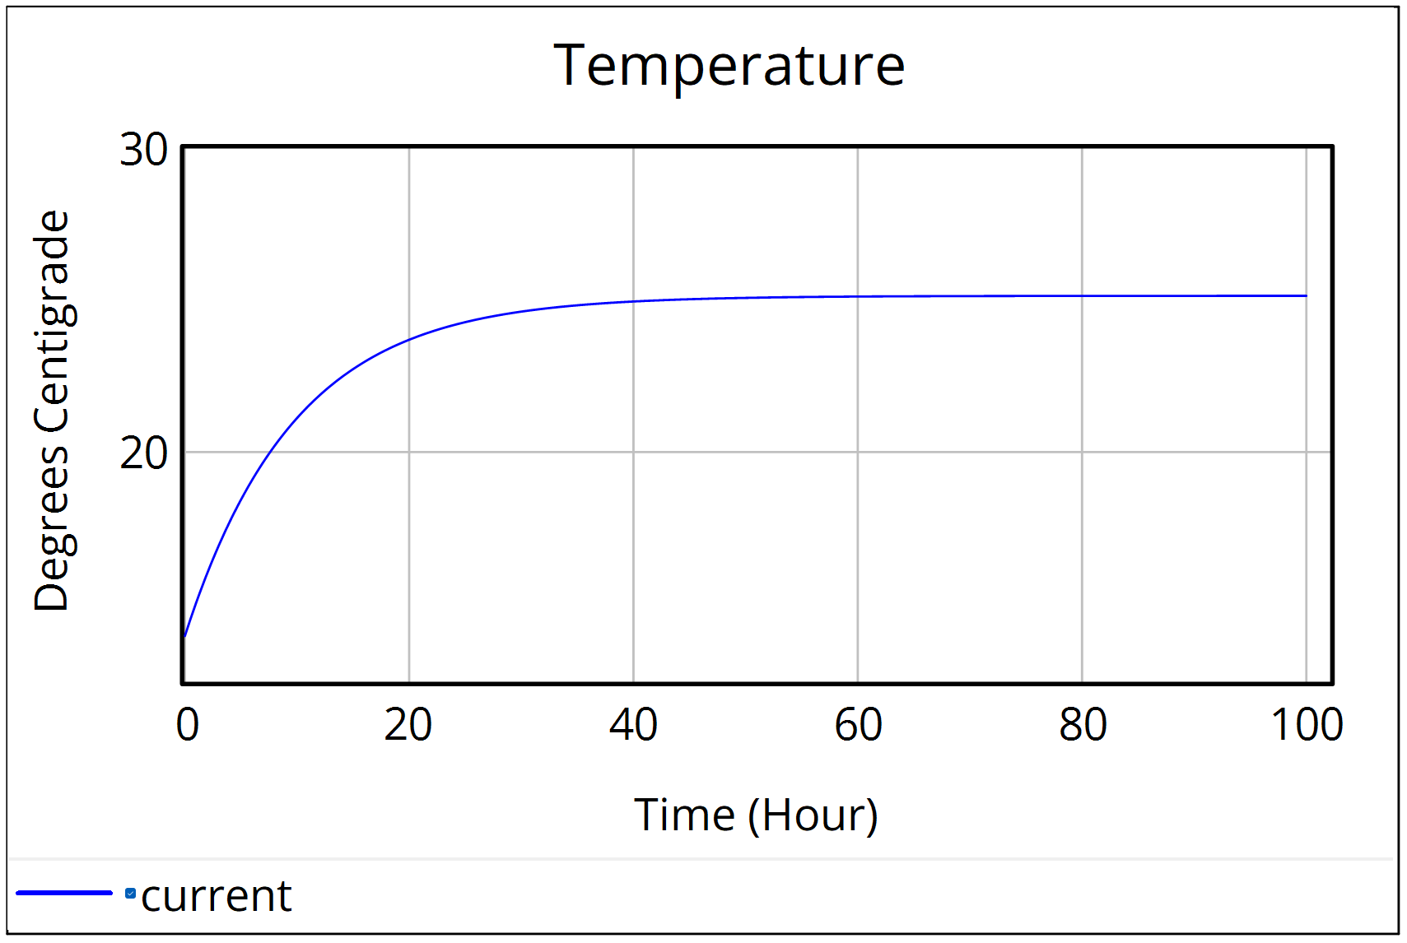
Balancing behaviour
Notes:
Tell attendees that balancing behaviour is usually caused by the presence of a balancing or negative feedback loop, where that negative feedback loop is dominating system behaviour.
Talk about where this is intentionally built into a system it is known as goal seeking behaviour.
Ask attendees if they can think of examples (a room thermostat is usually goal seeking behaviour).
Finally, point out that balancing loops bring stability to a system.

Slide 52
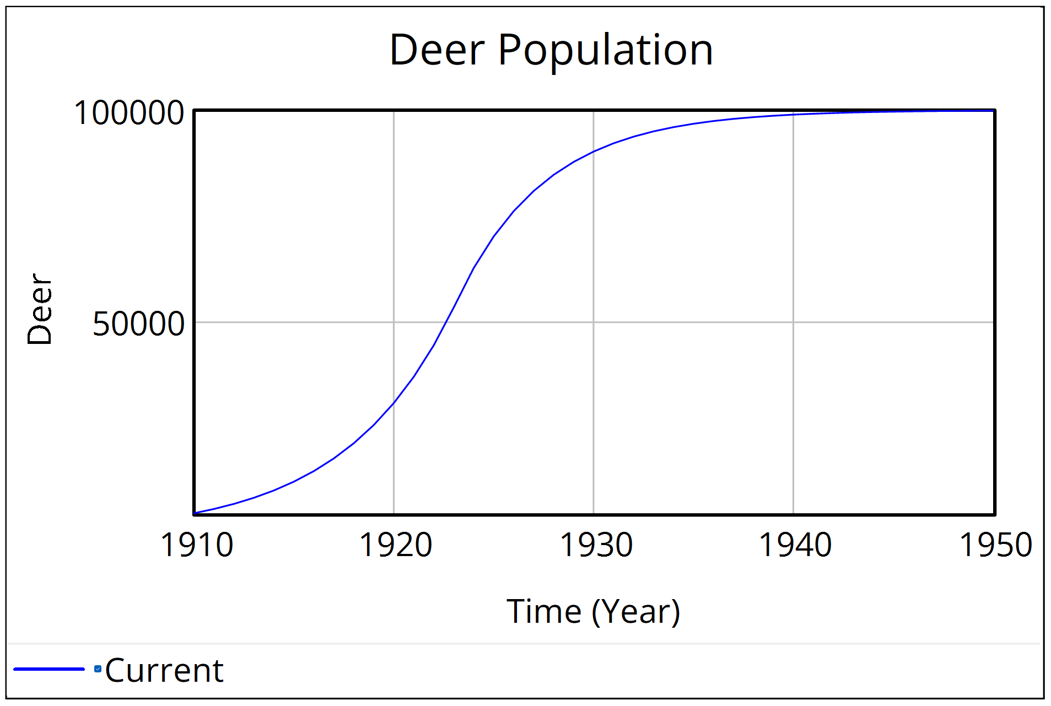
Growth, then levelling off
Notes:
Point out to attendees that growth then levelling off is a common system behaviour.
No physical system can grow infinitely, so all systems must approach a limit.
Point out to attendees that growth then levelling off is often caused by a system that has two feedback loops, one reinforcing and one balancing. During initial stages the reinforcing feedback loop is dominant. Later, as you approach saturation, the balancing loop becomes dominant.
Ask attendees for examples of growth then levelling off. Examples include population growth, market penetration.

Slide 53
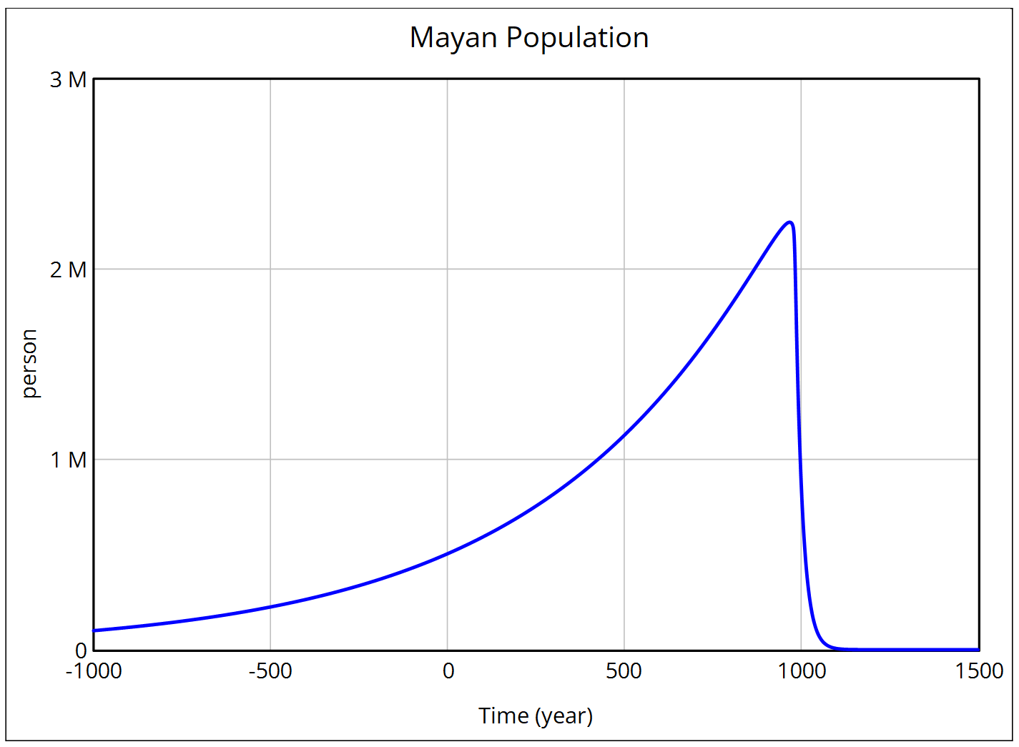
Overshoot and collapse
Notes:
Point out to attendees that overshoot and collapse typically occurs in systems where there is a renewable resource and that resource is harvested beyond a sustainable rate, so that the resource becomes depleted beyond the point at which it can recover.
Ask the attendees if they can think of examples of collapse. Examples include ancient civilisations, overfishing, overly intensive agriculture.
Ask attendees if they can think of examples within an organisation.
One example is firefighting into high levels of technical debt.

Slide 54
Systems, individuals, and technical debt
We’ll now look at some ways in which individuals pursuing their own goals whilst working within a system can drive technical debt:
1. Individuals constrained by role
2. Overdue projects and schedule recovery
3. Project underestimation
4. Overshoot and collapse
5. Policy resistance
Notes:
Briefly list the five ways that you will now go through how individuals working within systems can contribute to technical debt.

Slide 55
Individuals constrained by role
Notes:
Point out to attendees that individuals are often constrained by their role within a system or organisation.
Give an example of a project manager who knows that the suggested solution, although quick, will lead to longer term problems and is not in the best long-term interests of the organisation. Nevertheless, he or she is measured by their ability to deliver the project and are therefore constrained by their role.
If time permits, get attendees to break into small groups and discuss how each of them is constrained by their role into doing things that are good for the role but not necessarily good for the long-term benefits of the organisation. As previously, get those ideas down to post-it notes and up onto a board in a shared area.
Next, get attendees to break into small groups (or perhaps use 1-2-4-All) and identify possible ways that they could mitigate effects of individuals constrained by role.

Slide 56
Overdue projects and schedule recovery
Notes:
Identify how an overdue project and its subsequent attempt to recover schedule may lead individuals on that project to make decisions that lead to the buildup of technical debt.
Identify that this is distinct from the aspects discussed in the earlier section on trade-off decisions, but is more focused around the role the individual occupies.
Get attendees to break into small groups and discuss how their role within a project that is overdue may cause them to make decisions resulting in technical debt, even if they were not influenced by the factors discussed in the earlier section on trade-offs.
Next, get attendees to think up potential solutions. Candidate solutions include:
1. Avoid estimation errors, a common source of overdue projects.
2. Allow schedule recovery without comprising technical debt, by using approaches like Ulysses contracts, as discussed in the previous chapter.
3. Adopt a development method, such as agile, that is less vulnerable to estimation errors.
Beware of going too deep into solutions at this stage, as we are still wanting to focus on problem understanding.
For further details, refer to the relevant section 'overdue projects and schedule recovery' in chapter 6.

Slide 57
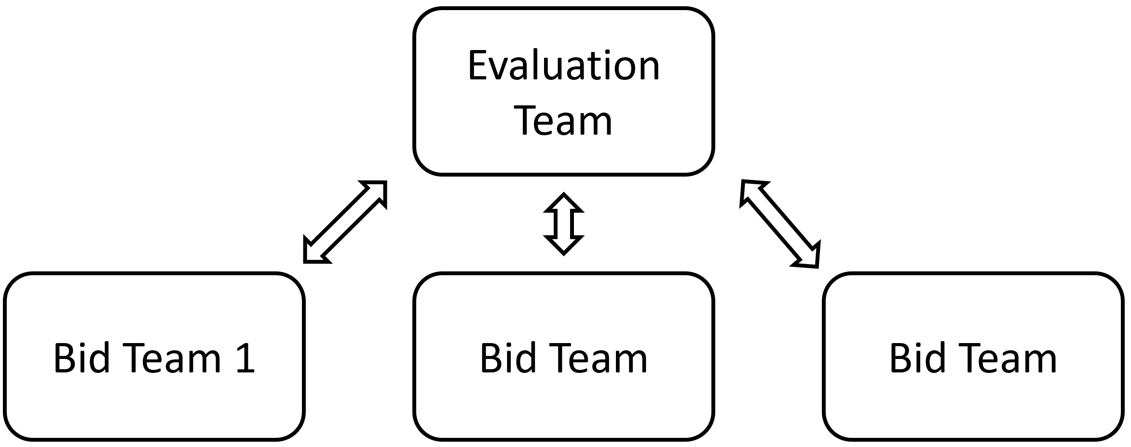
Project underestimation
Notes:
Ask the attendees how they estimate a project.
If the process sometimes includes a competitive bid process, ask them how they feel a competitive bid process contributes to an accurate or inaccurate estimation.
Get attendees to break into small groups and discuss.
Bring the teams together and discuss as a group. Write ideas up onto post-it notes and onto a board.

Slide 58
Overshoot and collapse
Notes:
Run through an example of how an ancient civilisation, such as the Mayan or Easter Island civilisations collapsed.
Alternatively, run through an example of how overfishing caused the irreversible collapse of fishing stocks in a specific location.
Next, break into small groups and get attendees to discuss how collapse occurs, based upon decisions by individuals, such as fishing boat captains. Get the groups to share the results with the whole workshop.
Next, ask the question – how could collapse occurs within a software development process for software development team within an organisation. Once again, break into small groups and get individuals to discuss. Then get the groups to share their results back to the workshop.
Prepare a slide with the anti-pattern – firefighting into technical debt (see chapter 9). However, hopefully, you will not need it, as at least one of the groups is likely to have worked through and identified a process leading to collapse.

Slide 59
Policy resistance
Where actors within a system find ways to work around the rules or policy, or otherwise behave in ways that negate the benefits intended by a policy change.
Notes:
Begin by giving example of policy resistance. For example, how highway improvements intended to relieve traffic congestion tend to end up providing only temporary relief, as highly improvements result in additional travel and hence congestion.
Identify that behaviour results in the negation of a policy change is very often the result of a balancing loop within the system.
Get attendees to break into small groups and discuss how and why an organisational directive to add an additional 20% to each project estimate is unlikely to lead to any reduction in project underestimation. Meet back up together and share the findings from each small group, putting pertinent ideas onto post-its on a board.
Next, get attendees to break into small groups and identify potential ways in which policy resistance could lead to an undermining of any technical debt reduction initiatives.

Slide 60
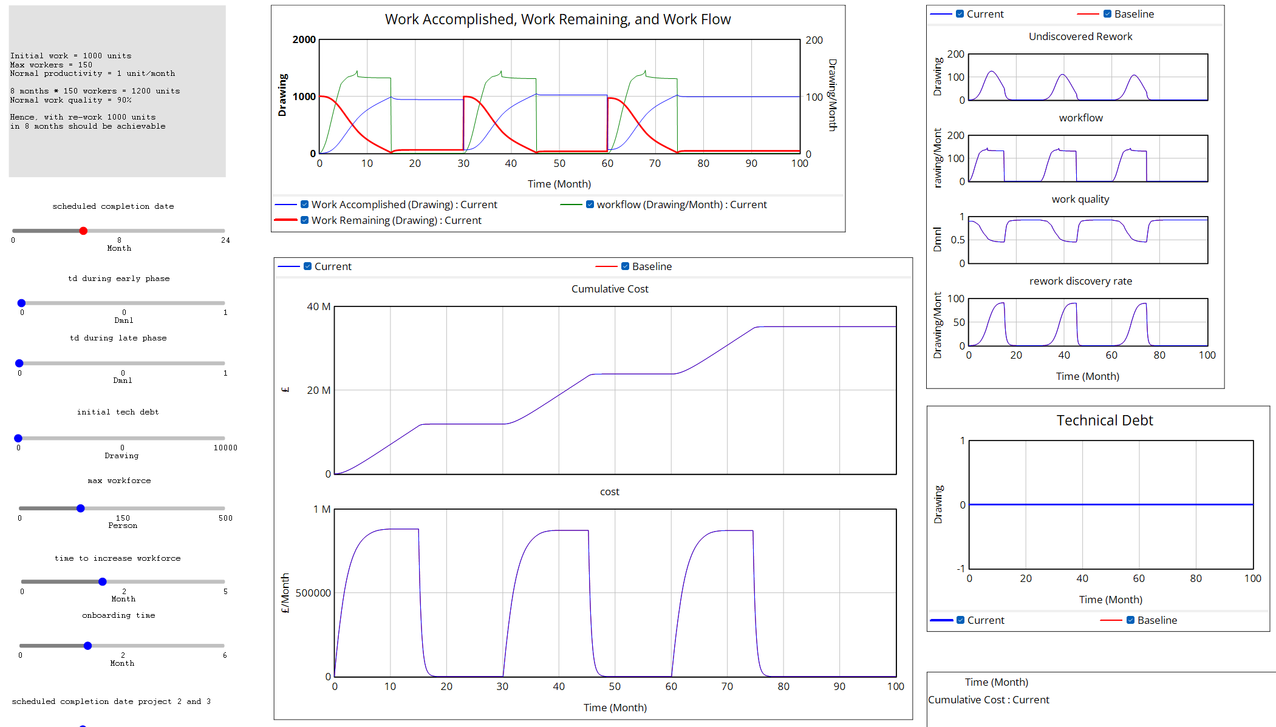
Exercise – Dynamic system model
Notes:
Load up the Vensim based model of a software development process, as discussed in chapter 10, then demonstrate it to the workshop attendees.
If attendees are able to load the Vensim model reader onto their laptops, distribute the model to individuals and get them to run the model.
Get them to work in small teams or individually, exploring the model and its behaviour.

Slide 61
Exercise – Brainstorming & discussion
Notes:
In the final exercise of this section, get the attendees to break into small groups and discuss ways in which system effects may be adversely affecting technical debt.
Get the groups to put the ideas onto post-its, then assemble those notes onto a common area of your board.

Slide 62
Summary: Understanding system effects
Notes:
Give a summary of the major points of this section – understanding system effects.
Begin by asking what is a system, then refer back to Donella Meadows' definition.
Rerun the slinky demo (this usually goes down well).
Recall that an organisation can be viewed as a system.
Identify the crucial difference between IT systems and social systems – that social systems have the subsystems that can determine and pursue their own personal goals.
Identify how making a change in a social system can lead to unexpected results – the Prohibition problem.
Next, identify those common dynamic system behaviours – exponential growth, balancing behaviour, growth then levelling off, and overshoot & collapse.
Recall how systems individuals in technical debt are related.
Briefly show the Vensim model and remind attendees that system behaviours can be understood by modelling their behaviour in dynamic modelling tools.

Slide 63
BREAK

Slide 64
Anti-patterns
Notes:
Identify to workshop attendees that we have now finished looking at technical debt as a systems problem and are now beginning to look at anti-patterns that are caused by that system.

Slide 65
Patterns and anti-patterns
Pattern: A general, repeatable solution to a commonly occurring problem. Often used in software design.
Anti-pattern: A common response to a recurring problem that is usually ineffective and often highly counterproductive.
Notes:
Refer to chapter 9 for material in this section
Ask the attendees what they know about patterns in software design.
Next, ask the attendees what they understand by the term anti-patterns.
Keep the discussion brief, spending no more than 3 to 5 minutes on this.

Slide 66
How exploring anti-patterns is helpful
Notes:
Ask attendees how they think exploring anti-patterns may be helpful.
Next, reveal the three areas where Antipatterns are useful:
• Understand the problem. By mapping the anti-pattern as a causal loop diagram (covered next), we can easily visualise and hence more readily understand it.
• Identify intervention points. By examining an anti-pattern, we can identify points where we can intervene and hence ‘nudge’ decisions in a better direction. In addition, if we can identify leverage points, then changes can be done more easily, with little resource expenditure. For example, if a person who wishes to stop smoking identifies that they only smoke whilst having a drink with fellow smokers down the pub, then this is an obvious leverage point to exploit.
• Facilitate discussion to reach common understanding. This is the most effective use of anti-patterns. In the chapter on Wicked Problems, we learned that a major difficulty of addressing technical debt was that different individuals had differing and often irreconcilable worldviews and frames of understanding. Exploring these anti-patterns as a facilitated group activity helps the group reach a common understanding.
Make sure that attendees understand that the greatest benefit of exploring anti-patterns is to facilitate that discussion and reach a common understanding.

Slide 67
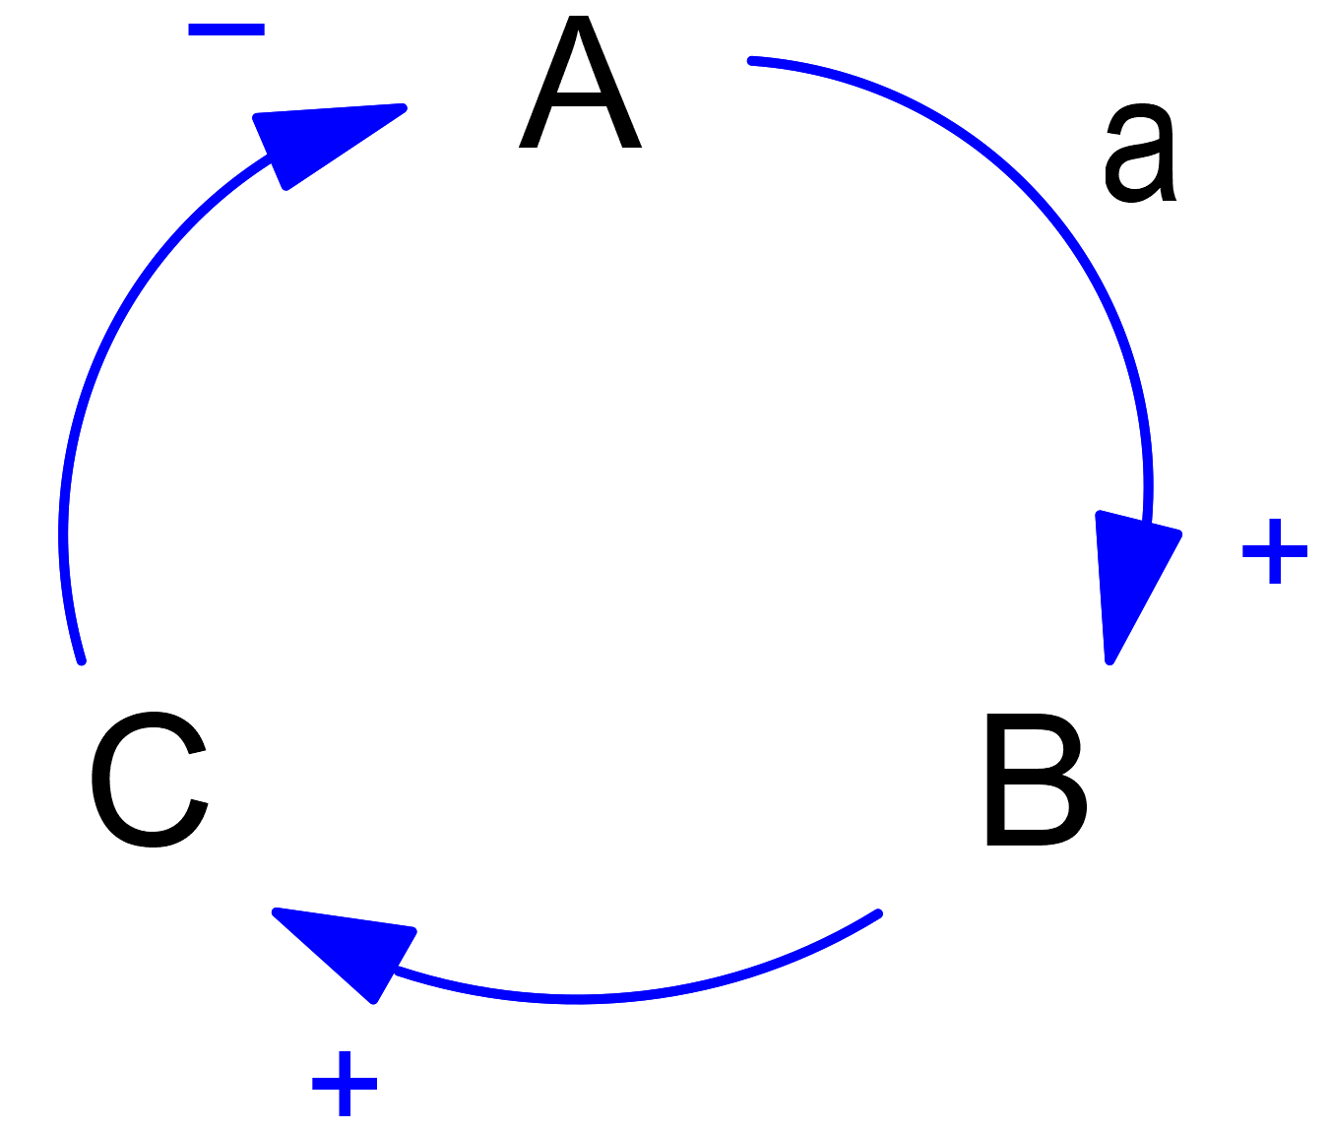
Causal Loop Diagrams
Notes:
Using the causal loop diagram displayed in the slide, explain how a causal loop diagram works.
Identify the variables, A, B, C.
Identify the relationships are indicated by the arrows, plus the direction of the arrows indicates the causal direction of the relationship.
Identify the meaning of the positive and negative signs at the arrowheads.
Tel attendees that they can build their own causal loop diagrams using a whiteboard or post-it notes.
Recommend that they start here, rather than with complex software tools.

Slide 68
Exercise - How could estimation errors lead to technical debt?
Notes:
Begin by posing the question, ‘How could estimation errors lead to technical debt’? Break the workshop into small groups and facilitate the building of the estimation trap anti-pattern/CLD. Use a whiteboard, rather than any software like mind mapping tools, MIRO, or Vensim.
Next, get the groups to compare their CLDs and invite discussion.
Finish by breaking attendees into small groups and working through another CLD, either one suggested by yourself or one which they create.

Slide 69
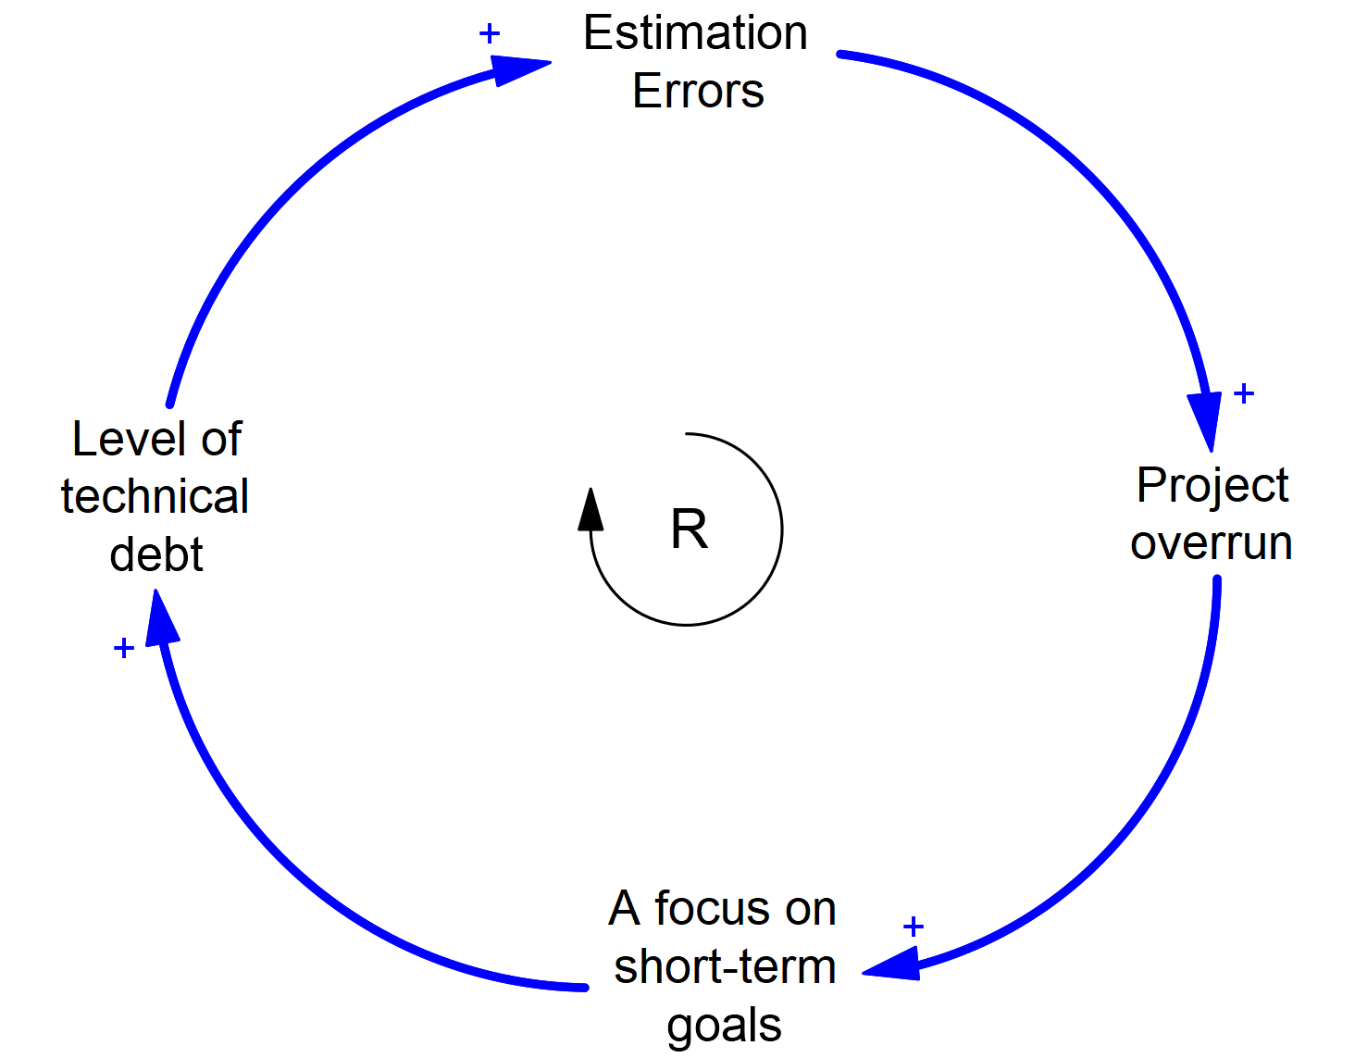
Exercise - Answer
Notes:
After the attendees have spent sufficient time in the exercise on creating a causal loop diagram for the estimation trap, work through an example answer, as indicated in the slide.
Get attendees to suggest what the next step is, rather than simply putting the answer to the board. For example, if you write 'estimation errors' on the board, then ask, "what could estimation errors lead to?"
When you hear a workshop attendee answer something similar to "Project overrun", then right that on the board and continue.

Slide 70
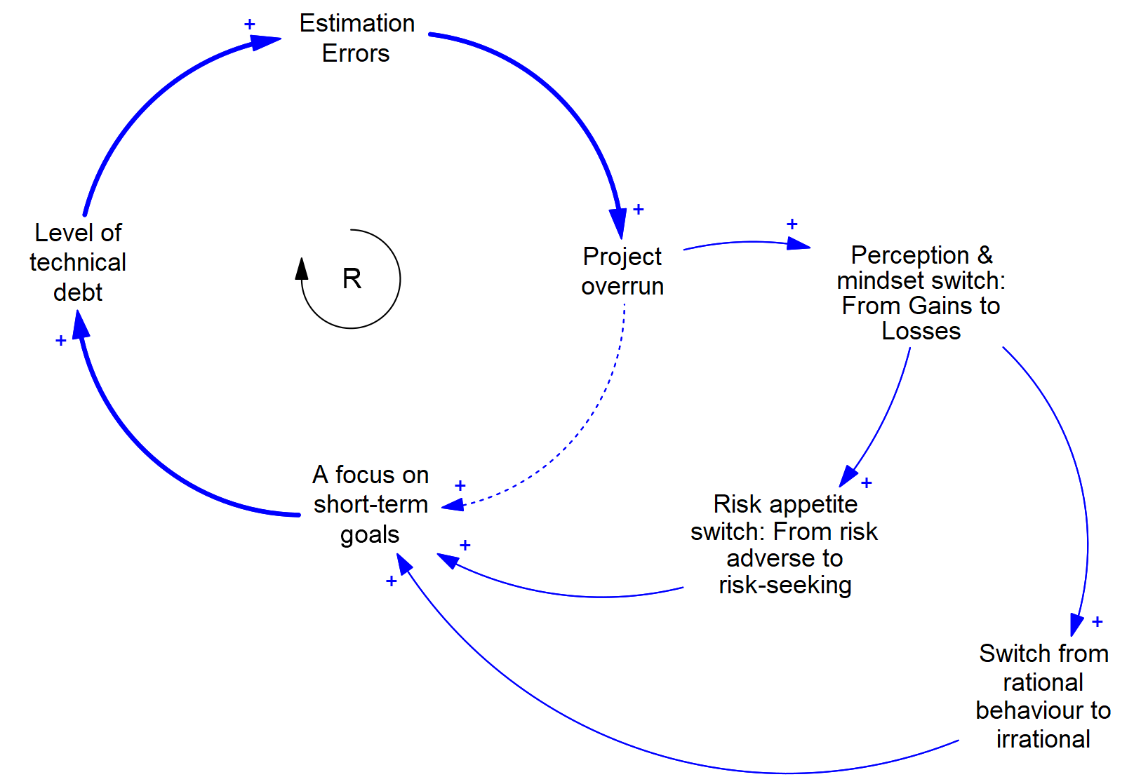
Exercise - Estimation errors & technical debt: a deeper dive
Notes:
Dive deeper into each of the stages.
Begin by showing the diagram above, then explain to attendees how a project that has overrun always behind schedule leads to a change in the mindset of individuals on the project. It switches them from a mindset of gains to one of losses.
Then explain how this causes a switch in risk appetite – from risk adverse to risk seeking – plus a switch from rational to irrational behaviour. These in turn lead to a focus on short-term goals.
Next, ask the attendees to return to their small groups and try and work out more detailed steps between a focus on short-term goals and level of technical debt.

Slide 71
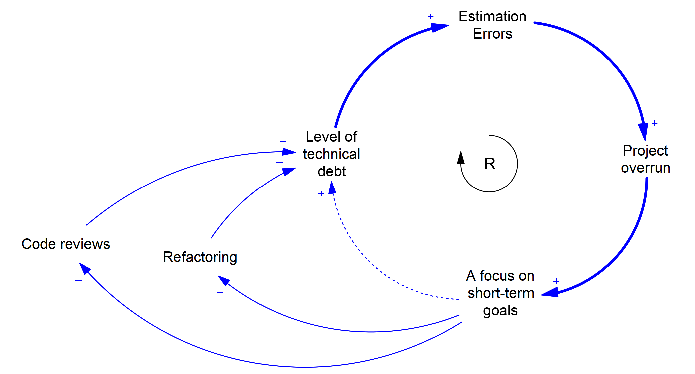
Exercise - Estimation errors & technical debt: a deeper dive
Notes:
If time permits, repeat the previous exercise but for this stage.

Slide 72
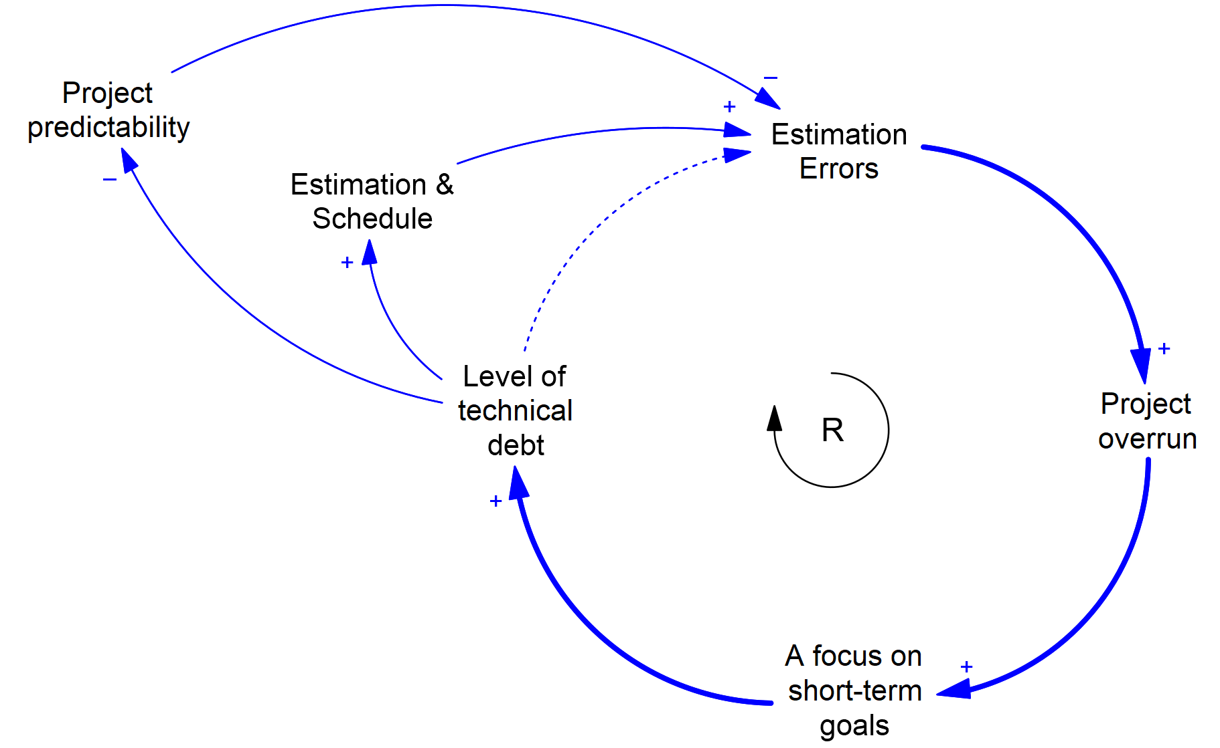
Exercise - Estimation errors & technical debt: a deeper dive
Notes:
If time permits, repeat the previous exercise but for this stage.

Slide 73
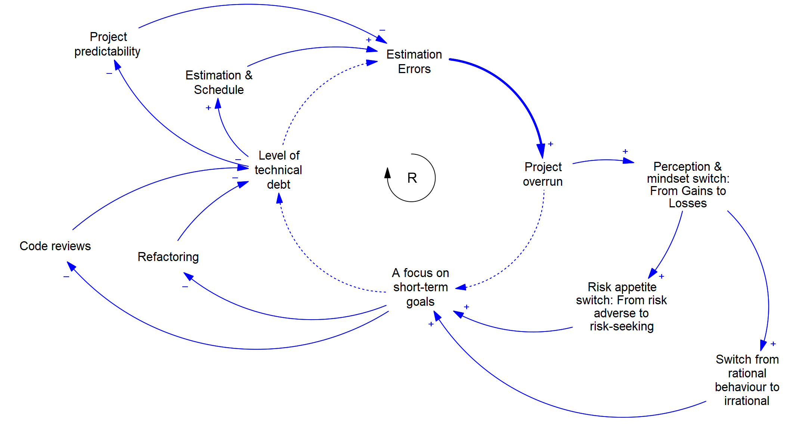
Exercise - Estimation errors & technical debt: a deeper dive
Notes:
Show the complete diagram to attendees.
Explain how you can use these diagrams to better understand behaviour, look for leverage points, and develop a shared understanding with your colleagues.
Also mention that you can use these diagrams to build dynamic models, like the one they used in the previous session.

Slide 74
Exercise - Social loafing
Social loafing is where a person exerts less effort when part of a group than when alone
Not about laziness
About being overloaded
Notes:
Get attendees to break into small groups and worked through a causal diagram of how social loafing may occur within software development.
Point out that the diagram not include a loop.

Slide 75
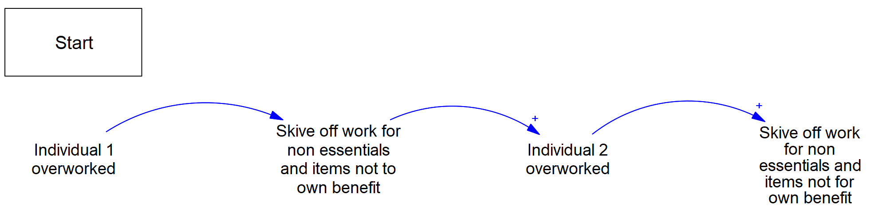
Exercise answer - Social loafing
Notes:
Bring the goods back together, then work through a solution on a whiteboard.

Slide 76
Simulation - Social loafing
Notes:
If attendees are able to load the Vensim model reader onto their laptops, distribute the social loafing model to individuals and get them to run the model.
Get them to work in small teams or individually, exploring the model and its behaviour.
Afterwards, bring the group together and open up a discussion.
- To an extent our conditions present for social loafing within our organisation?
- Social loafing occur?
- If it occurred, would we even know about it?
- What can we do to reduce its prevalence?

Slide 77
Exercise - Descent into firefighting
Notes:
Explain the concept of descent into firefighting.
Next, get attendees to break out into small groups and work out a causal loop diagram for the process.

Slide 78
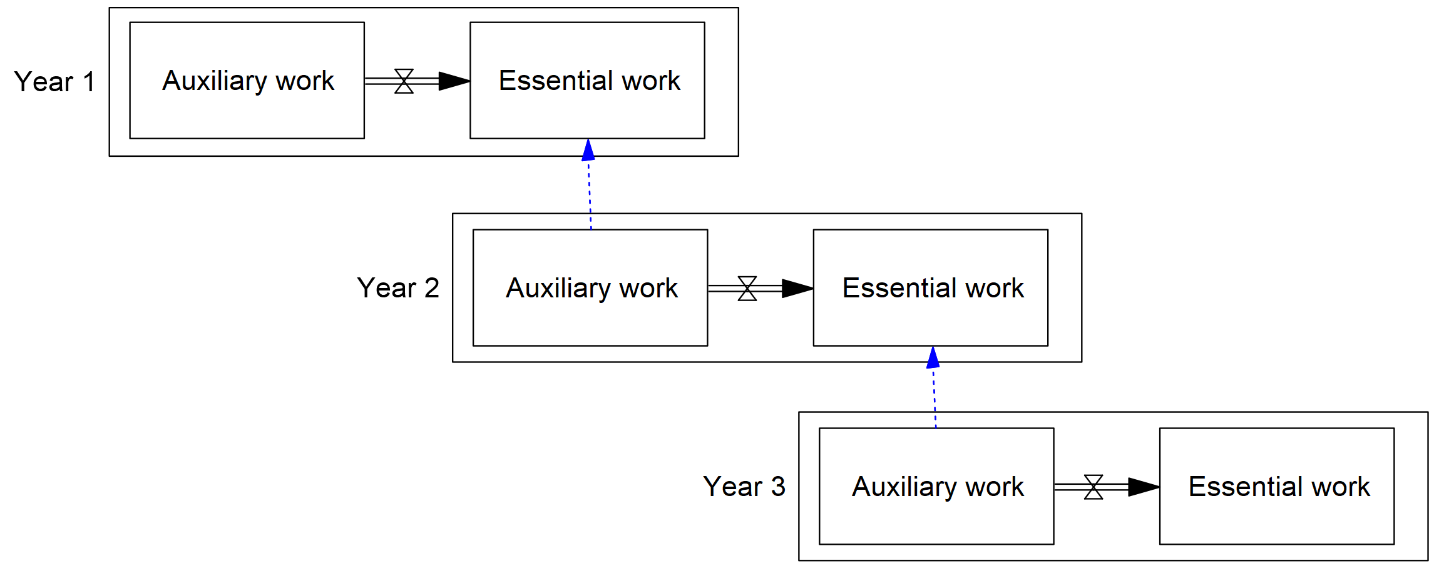
Exercise answer - Descent into firefighting
Notes:
Explain how descent into firefighting occurs, as was discussed in chapter 9.
Year one project gets into trouble and cannot complete its essential work. Resources are diverted from year two auxiliary work on to you one essential work. This allows you want to complete, but now leaves year two in trouble when it comes to its essential work. And so on.

Slide 79
Other anti-patterns
1. The estimation trap
2. Last race of the day
3. Moral credential effect
4. Broken windows theory and learned helplessness
5. Goal culture
6. Social loafing
7. OKRs and the surrogation effect
8. Descent into firefighting
9. Limited environments
10. Prototype into debt
Notes:
Briefly run through an example list of anti-patterns that occur in software development.

Slide 80
Summary: anti-patterns
Notes:
Summarise the key points of this anti-patterns session.
What anti-patterns are.
Benefits of using anti-patterns.
Causal Loop diagrams.
The estimation trap.
Social loafing.
Descent into firefighting.

Slide 81
Summary: Day 1

Slide 82
Summary: Day 1
Notes:
Provide a summary of the major sections of day one.
What is technical debt?
Technical debt and trade-off decisions.
Technical debt and systems effects.
Anti-patterns

Slide 83
Recap: Day 1

Slide 84
Recap: Day 1
Notes:
Provide a recap of the major sections of day one.
(essentially, this is your summary of day 1)
What is technical debt?
Technical debt and trade-off decisions.
Technical debt and systems effects.
Anti-patterns
Spend no more than 15 minutes on this area.
Try doing it as an interactive Q & A session.

Slide 85
Agenda: Day 2

Slide 86
Agenda day 2
Recap of day 1 (15 m)
Technical debt from an economics PoV (90 m)
BREAK (15 minutes)
Wicked problems, social complexity, and fragmentation (90 m)
LUNCH (60 minutes)
Putting it all together (180 m)
Summary of day 1 and 2 (30 m)
Notes:
Provide an agenda for day 2, so attendees understand where they are going throughout the day.

Slide 87
Technical debt from an economics Point of View
Notes:
In this section, take the workshop attendees through understanding technical debt in terms of a series of well understood (understood by economists!) series of problems.

Slide 88
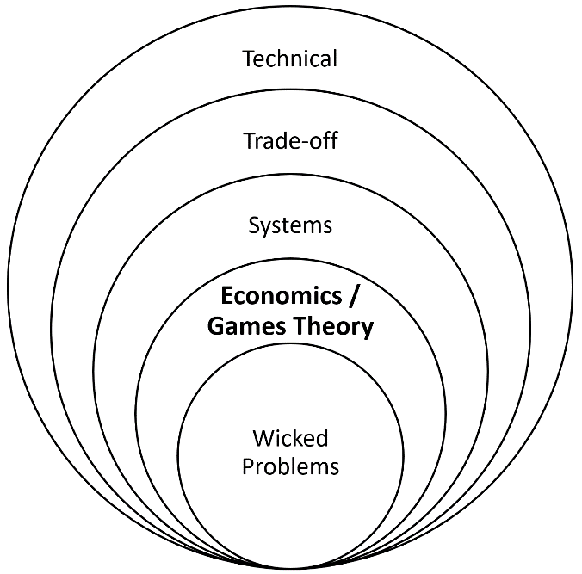
Notes:
Identify to workshop attendees that we have now finished looking at anti-patterns and are now beginning to look at technical debt from an economics point of view.

Slide 89
Benefits of an economics point of view
The benefits of exploring technical debt from an economics point of view are threefold:
Fresh perspectives offer new insights, plus potential solutions.
Economics offers many fruitful lessons.
Economics offers us a common language.
Notes:
Explain to attendees the benefits of looking at technical debt from an economics point of view. Those benefits are:
Economics offers a fresh perspective.
Economics offers fruitful lessons.
Economics offers a common, authoritative language.
As always, try to make it as interactive as possible. One way is to ask questions of the attendees.
Aim to spend no more than 5 minutes on this slide.

Slide 90
Economic problems we’ll examine
Principal-agent problem
Tragedy of the commons
Externalities
Short-termism
Tyranny of small decisions
Creeping normality
Price of anarchy
Moral hazard
Notes:
Briefly list and define the eight problems that will explore within this section.
Highlight your attendees that even if you only spent 10 minutes on each problem, that would consume the entire time available for the session.
Therefore, state that you will go into some of the problems in more depth, whilst skimming over others.
(I would suggest prioritising the principal-agent problem, tragedy of the Commons, externalities, and, perhaps, creeping normality.)
Principal-agent problem. The people who do the work and the people who want work done have different objectives, leading to a conflict of interests
Tragedy of the commons. It’s rational to take as much as you can from a common resource if you don’t pay the consequences of that extraction. This leads to resource destruction, despite nobody wanting that to occur.
Externalities. This is where one party can impose costs upon another without the other party having a say in the matter.
Short-termism. What is in an agent’s short-term interests is different from their long-term interests.
Tyranny of small decisions. Lots of small decisions add up to a larger, bad decision, one that we probably wouldn’t have made.
Creeping normality. A major change can be accepted as normal, provided it happens gradually through small increments.
Price of anarchy. There is often a substantial price to pay for allowing multiple agents to act in their own self-interest.
Moral hazard. When people who benefit from taking a risk are divorced from the consequences of their actions, risk-taking increases and bad things happen.

Slide 91
Principal-agent problem
The principal-agent problem is a conflict in interests and priorities that arises when one party, the agent, carries out actions on behalf of another party, the principal. – Eisenhardt, K. (1989).
For this problem to occur, at least one of the following must be present:
A discrepancy of interests exists between the principal and agent.
Asymmetric information, with the agent possessing information that the principal lacks.
The principal lacks the means to reward, punish, or otherwise influence the agent.
Notes:
Describe your attendees the principal-agent problem and the characteristics that must be present for it to exist.
Next, get the workshop to break into small groups (or use 1-2-4-All).
Get attendees to discuss where they may encounter the principal agent problem in their software development processes, plus to think about potential mitigation factors.
Get attendees to write their ideas on post-it notes and put them onto a board.
Next, get a representative from each group to briefly discuss their main findings to the rest of the workshop, whilst inviting comment from other teams.
Be mindful of the time and aim to limit this to 15 to 20 minutes.

Slide 92
Tragedy of the commons
Notes:
Describe your attendees the tragedy of the Commons problem and the characteristics that must be present for it to exist.
Next, get the workshop to break into small groups (or use 1-2-4-All).
Get attendees to discuss where they may encounter this problem in their software development processes, plus to think about potential mitigation factors.
Get attendees to write their ideas on post-it notes and put them onto a board.
Next, get a representative from each group to briefly discuss their main findings to the rest of the workshop, was inviting comment from other teams.
Be mindful of the time and aim to limit this to 15 to 20 minutes.

Slide 93
Externalities
Notes:
Describe your attendees the externalities problem and the characteristics that must be present for it to exist.
Next, get the workshop to break into small groups (or use 1-2-4-All).
Get attendees to discuss where they may encounter this problem in their software development processes, plus to think about potential mitigation factors.
Get attendees to write their ideas on post-it notes and put them onto a board.
Next, get a representative from each group to briefly discuss their main findings to the rest of the workshop, was inviting comment from other teams.
Be mindful of the time and aim to limit this to 15 to 20 minutes.

Slide 94
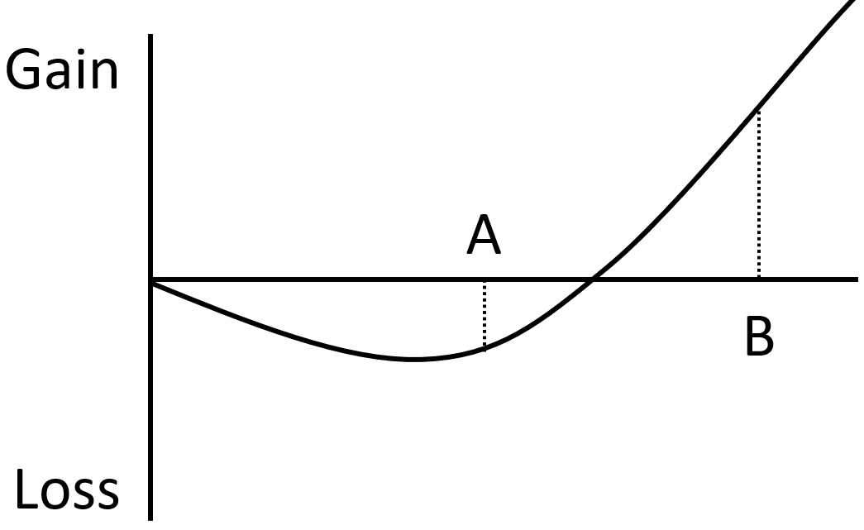
Short-termism
Short-termism: A way of thinking or planning that only considers the advantages or profits you could have now, rather than the effects in the future. – Oxford learner’s dictionary.
Notes:
Briefly describe short termism to the workshop attendees.
Reiterate that, given time constraints, you cannot go into this in as much depth as you would like, but attendees can find more information on this topic within the relevant section of the technical debt book.

Slide 95
Tyranny of small decisions
Notes:
Briefly describe the tyranny of small decisions to the workshop attendees.
Reiterate that, given time constraints, you cannot go into this in as much depth as you would like, but attendees can find more information on this topic within the relevant section of the technical debt book.

Slide 96
Creeping normality
Notes:
Describe your attendees the creeping normality problem.
Next, get the workshop to break into small groups (or use 1-2-4-All).
Get attendees to discuss where they may encounter this problem in their software development processes, plus to think about potential mitigation factors.
Get attendees to write their ideas on post-it notes and put them onto a board.
Next, get a representative from each group to briefly discuss their main findings to the rest of the workshop, was inviting comment from other teams.
Be mindful of the time and aim to limit this to 15 to 20 minutes.
If you are running out of time, do not do the exercise.

Slide 97
Price of anarchy
Notes:
Briefly describe the price of anarchy to the workshop attendees.
Reiterate that, given time constraints, you cannot go into this in as much depth as you would like, but attendees can find more information on this topic within the relevant section of the technical debt book.

Slide 98
Moral hazard
Notes:
Briefly describe moral hazard to the workshop attendees.
Reiterate that, given time constraints, you cannot go into this in as much depth as you would like, but attendees can find more information on this topic within the relevant section of the technical debt book.

Slide 99
Summary: Technical debt from an economics PoV
Notes:
Summarise the main points of this section.
Briefly list the eight economic problems.
Importantly, list any findings that the attendees identified and posted onto the board.

Slide 100
BREAK

Slide 101
Wicked problems, social complexity, and fragmentation
Notes:
In this section, take the workshop attendees through what a wicked problem is, its relevance to technical debt, plus approaches for addressing wicked problems.

Slide 102
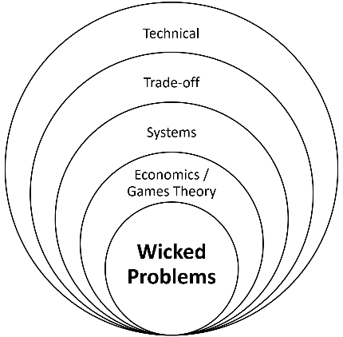
Notes:
Identify to workshop attendees that we have now finished looking at technical debt from an economics point of view. and are now beginning to look at technical debt as a wicked problem

Slide 103
Wicked & tame problems
Wicked problem: A problem that is impossible to fully solve due to its characteristics, which include incomplete, contradictory, and changing information, its interconnected nature, diverging viewpoints and an absence of a true-or-false solution.
Notes:
Define what a wicked problem is (as shown in the slide text).
Next, define what a tame problem is, then give an example (chess, crossword puzzle, and so on).

Slide 104
Characteristics of a wicked problem
You cannot understand the problem until after you have found a solution.
Stakeholders have radically different worldviews and different frames for understanding the problem.
How you currently understand the problem determines what you will try as a solution.
Solutions to wicked problems are not true-or-false, but better or worse.
You do not have an immediate and conclusive test to see if your solution has worked.
Every solution to a wicked problem is a "one-shot attempt”.
Wicked problems are interconnected with other wicked problems.
You have no way of knowing when to stop.
Notes:
Work through the list of characteristics that wicked problems commonly have, as listed on the slide.
Briefly explore with the workshop attendees why these characteristics may make a wicked problem difficult to solve.
Do not spend too much time on this slide, as it is easy to get sucked into long discussions. Instead, get attendees into the exercise in the next slide.
However, do ensure that the workshop attendees are aware that there is far more material available about these characteristics within the technical debt book.
(Note: whilst the workshop is working in small groups in the exercise, they may find it useful to be able to refer to these characteristics. Therefore, either leave the slide visible during the exercise, or print out these characteristics and make them available on the tables that the groups are working at.)

Slide 105
Exercise: Example wicked problem
Zabalon is a fictitious country that has recently introduced legislation requiring organisations with manufacturing within that country to meet increasingly tough carbon reduction targets.
Discuss what are the likely consequences.
Notes:
Get the workshop groups to discuss what are the likely consequences.
Suggest to the groups that they spend part of their time imagining themselves as the CEO of such a manufacturing company, but is now faced with meeting these targets, whilst facing stiff competition and cost pressures.
This imaginary scenario is, of course, the EU. The solution many organisations found was to offshore manufacturing outside the EU, which significantly increased the carbon footprint. Firstly, these factories were not bound by any carbon reduction targets. Secondly, there was the additional carbon footprint of transportation from halfway across the world.
Aim to spend 10 to 15 minutes on this problem.
Afterwards, gather the groups together and briefly discuss their main findings.

Slide 106
Exercise:
Get each group to map out and discuss how closely the technical debt problem matches the characteristics of a wicked problem.
Carry out a facilitated group discussion of the technical debt wicked problem.
Notes:
Get each group to map out and discuss how closely the technical debt problem matches the characteristics of a wicked problem.

Slide 107
Social complexity and fragmentation
Social complexity: The number and diversity of players who are involved in a project. – Conklin, Jeff. Dialogue Mapping.
Fragmentation = wickedness x social complexity. – Conklin, Jeff. Dialogue Mapping.
Notes:
Next, discuss what social complexity is, plus how it combines with wickedness to produce fragmentation.
Identify to workshop attendees that technical debt is a wicked problem (which they should have worked out from the exercise), and that the fragmentation of different groups within the organisation will make it more difficult to solve the technical debt problem.

Slide 108
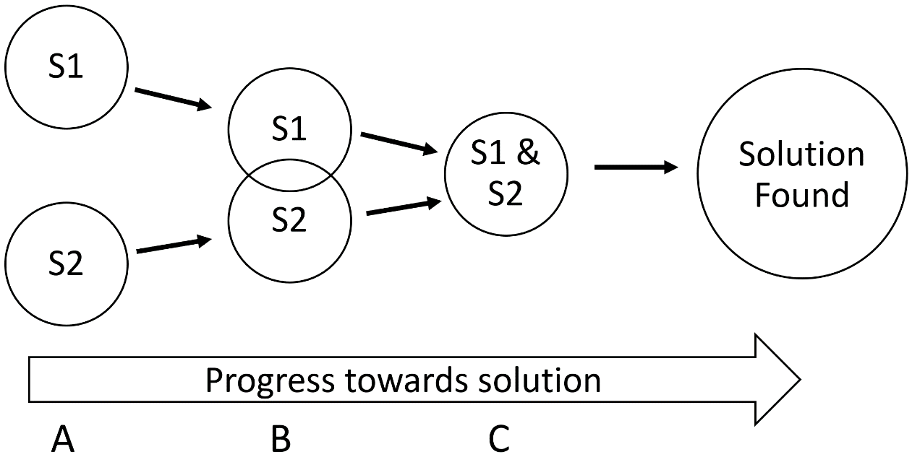
Social complexity and fragmentation
Notes:
Discuss with workshop attendees how the different specialisms within the organisation (for example business and technical) need to come to a shared understanding of the problem.
Emphasise that shared understanding does not mean that different specialisms agree with each other on all aspects of technical debt, but rather that all specialisms have sufficient understanding of each other and their problems that they can have an intelligent conversation about how to address the issue.

Slide 109
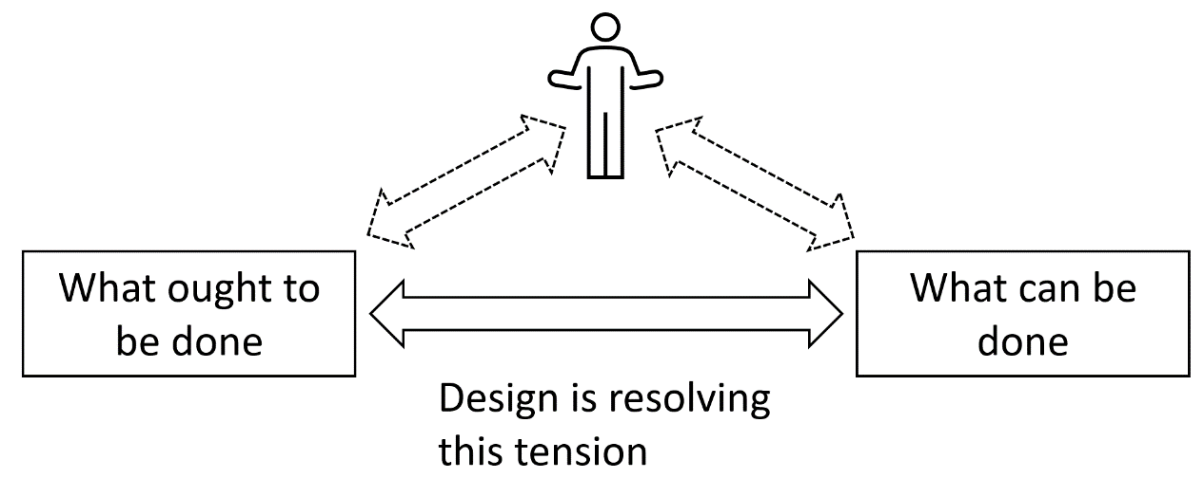
Dichotomy of design
Notes:
Discuss how resolving the problems of technical debt, or indeed any other wicked problem, usually involve resolving a dichotomy between what ought to be done and what can be done.
Discuss how, if this resolving this dichotomy is entirely down to a single individual, then it is possible, although not easy, for the individual to come to a resolution within themselves.

Slide 110
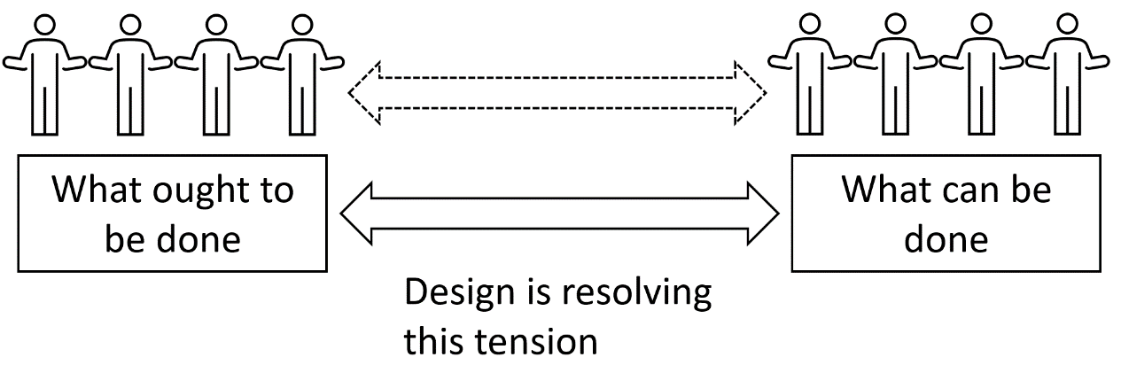
Dichotomy of design
Notes:
Now talk about how an organisation is typically structured so that individuals perform distinct roles, and those distinct roles usually put us into one side or the other of that dichotomy. Rarely do we stand on both sides of that dichotomy.
Discuss how this leads to the fragmentation of organisations into warring factions.
However, before this discussion gets too far, moving to the exercise on the next slide.

Slide 111
Exercise: Discussion
Break into small groups and discuss social complexity & fragmentation, how these might affect addressing technical debt within the organisation, plus how this can be counteracted.
Notes:
Get the workshop to break into small groups.
You may wish to consider the composition of those groups.
People tend to sit with the specialisms, so you'll find that the developers are sitting together, the testers are often sitting together, and business is sitting together.
You may wish to mix up the composition, so that you do not have groups composed of single specialisms.
Pose questions to the workshop. For example.
Is fragmentation contributing towards our technical debt problem?
If so, what things could we try to address it?
Periodically pull the small groups together for an all workshop update on their findings, which, as always, you should be aiming to capture on post-its and putting onto a board.
You are now trying to transform your workshop away from teaching the attendees about different aspects of the technical debt problem, and moving it towards the workshop attendees exploring for themselves the technical debt problem, using the tools and understanding they have acquired over the past day and a half.

Slide 112
Summary
Notes:
Summarise the main points of this section.
Briefly recap what a wicked problem is, how it differs from a tame problem, then list out the characteristics of a wicked problem.
Next, briefly recap social complexity and fragmentation.
Finish by listing out the pertinent findings from the final discussion on technical debt, which should be on the post-it notes on the board.

Slide 113
Putting it all together
Notes:
In this section, we look to pull together our new understanding of the technical debt problem.
We combine our understanding of the problem as a trade-off problem, systems problem, economics problem, and wicked problem. We look to use our understanding of anti-patterns and dynamic system models.
We are looking to put together our PROBLEM UNDERSTANDING, so that we come away from this workshop with a comprehensive understanding of our technical debt problem.
Try to resist workshop attendees diving into problem solution mode. Once people do this, they tend to not progress any further their understanding of the problem.

Slide 114
Exercise
What do we now understand about our technical debt problem?
What are the factors driving our technical debt creation?
What are the factors making our technical debt unnecessarily worse?
What is mitigating our technical debt? Something we don’t want to lose?
How is the way that we make trade-off decisions, i.e. using the affect heuristic, influencing our levels of technical debt?
How are project factors, such as schedule overrun, influencing our mindset and hence our decision-making?
How are the systems factors and our organisational setup influencing the creation of technical debt?
How are the economists’ problems influencing the creation of technical debt?
How are the wickedness aspects of technical debt influencing its creation?
How might social complexity and fragmentation inhibit us getting to a solution?
Where are we missing information that we need to get?
Notes:
Remember, you are focussed on PROBLEM UNDERSTANDING.
Try to avoid people rushing into solution mode.
The above slide shows a selection of questions that have proved useful in helping teams better understand the technical debt problem.
Show these questions, or a selection of these questions, or your own questions to the workshop attendees.
Next, get them to break into small groups or use the 1-2-4-All technique to discuss a selected question.
Periodically bring the attendees back together to discuss their findings so far, and get those findings onto post-it notes and on that board.
If the attendees appear to be flagging, losing energy, losing interest, look to regain the energy with one or more of the following options.
Select a new question for the attendees to consider.
Rearrange the groups into new compositions.
Try out one of the many techniques available from Liberating Structures or Red Teams.
If one group appears to be following a particularly fruitful line of enquiry, allow them to share it with the other groups.
Remember, what you are trying to achieve it is a new and enhanced understanding of the technical debt problem that is shared by all the relevant stakeholders within the organisation.

Slide 115
Summary
Notes:
Summarise the main points of this section.
Finish by listing out the pertinent findings from the discussions on technical debt, and aim to put together statements that sum up the workshop’s understanding of their technical debt problem.

Slide 116
Summary – Whole workshop

Slide 117
Summary
Notes:
Summarise the main points of this workshop.
The technical debt onion
The trade-off problem and the affect heuristic
Systems effects and their influence on technical debt
Anti-patterns.
Technical debt as an economics problem.
Technical debt as a wicked problem.
Putting it all together & our understanding of our technical debt problem.
Finish by listing out the pertinent findings from the discussions on technical debt, and aim to put together statements that sum up the workshop’s understanding of their technical debt problem.

